Slide 1
In-Depth Security for your On-Premises SQL Server Data Platform
Data Left Unattended, Amsterdam

Slide 2


















“It's not a matter of if, but when…”

Slide 3




Danny de Haan
he/him
Solutions Engineer
Redgate Software
Seasoned IT professional with nearly 20 years of experience, specializing in SQL Server and the Microsoft Data Platform.
With over 15 years dedicated to SQL Server, focusing on Security, Risk Management, and Compliance, ensuring that industry best practices and regulatory requirements are met from an infrastructural perspective.
/in/dannydh/
ThatInfraDba@pm.me
www.thatinfradba.com

Slide 4
Session goals
Layers of cybersecurity
Lateral movement
SQL Server Security
Where to get started

Slide 5
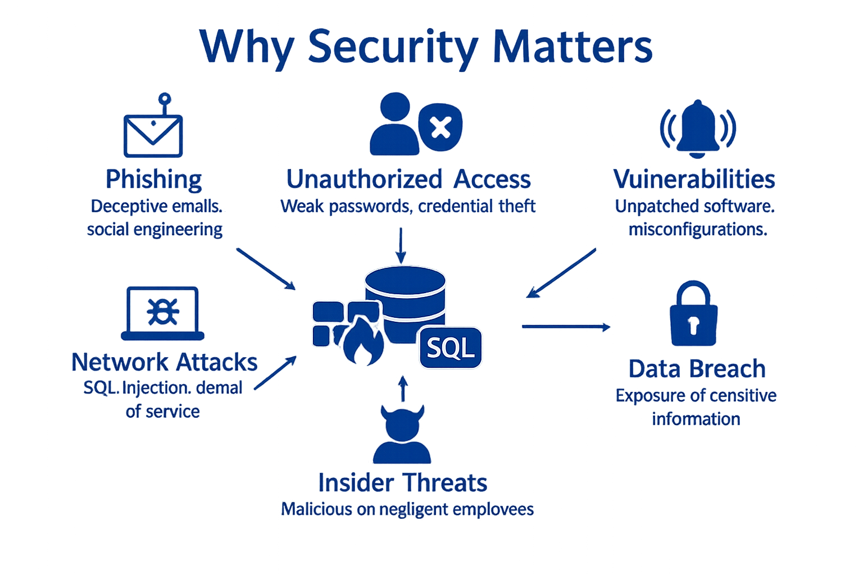
The SQL Server Threat Landscape

Slide 6
7 Layers of Cybersecurity
Perimeter
Network
Endpoint
Application
Data
Mission Critical
Human

Slide 7
The SQL Server Threat Landscape

Slide 8
nmap
krbtgt
credential guard
pass the hash
golden ticket
mitm
gMSA
metasploit
mimikatz
spn
nessus
pass the ticket
kerberoasting
xss
invicti
bloodhound
silver ticket

Slide 9
Lateral Movement
Explore network
Find vulnerabilities
Escalate privileges
Reach the target

Slide 10
Prevention of Lateral Movement
Principle of Least Privilege
Segregation of Duties
Account Segregation
Application Segregation

Slide 11
How to identify SQL Servers
SQLCMD

Slide 12
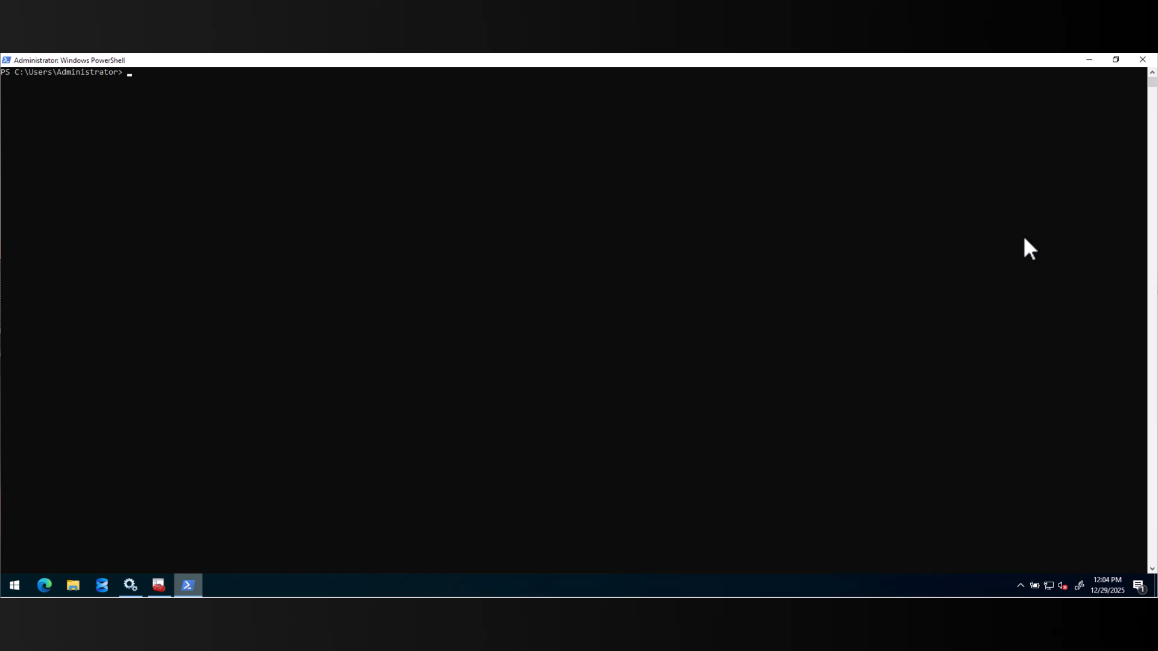
How to identify SQL Servers

Slide 13
How to identify SQL Servers
SQLCMD
SPN

Slide 14
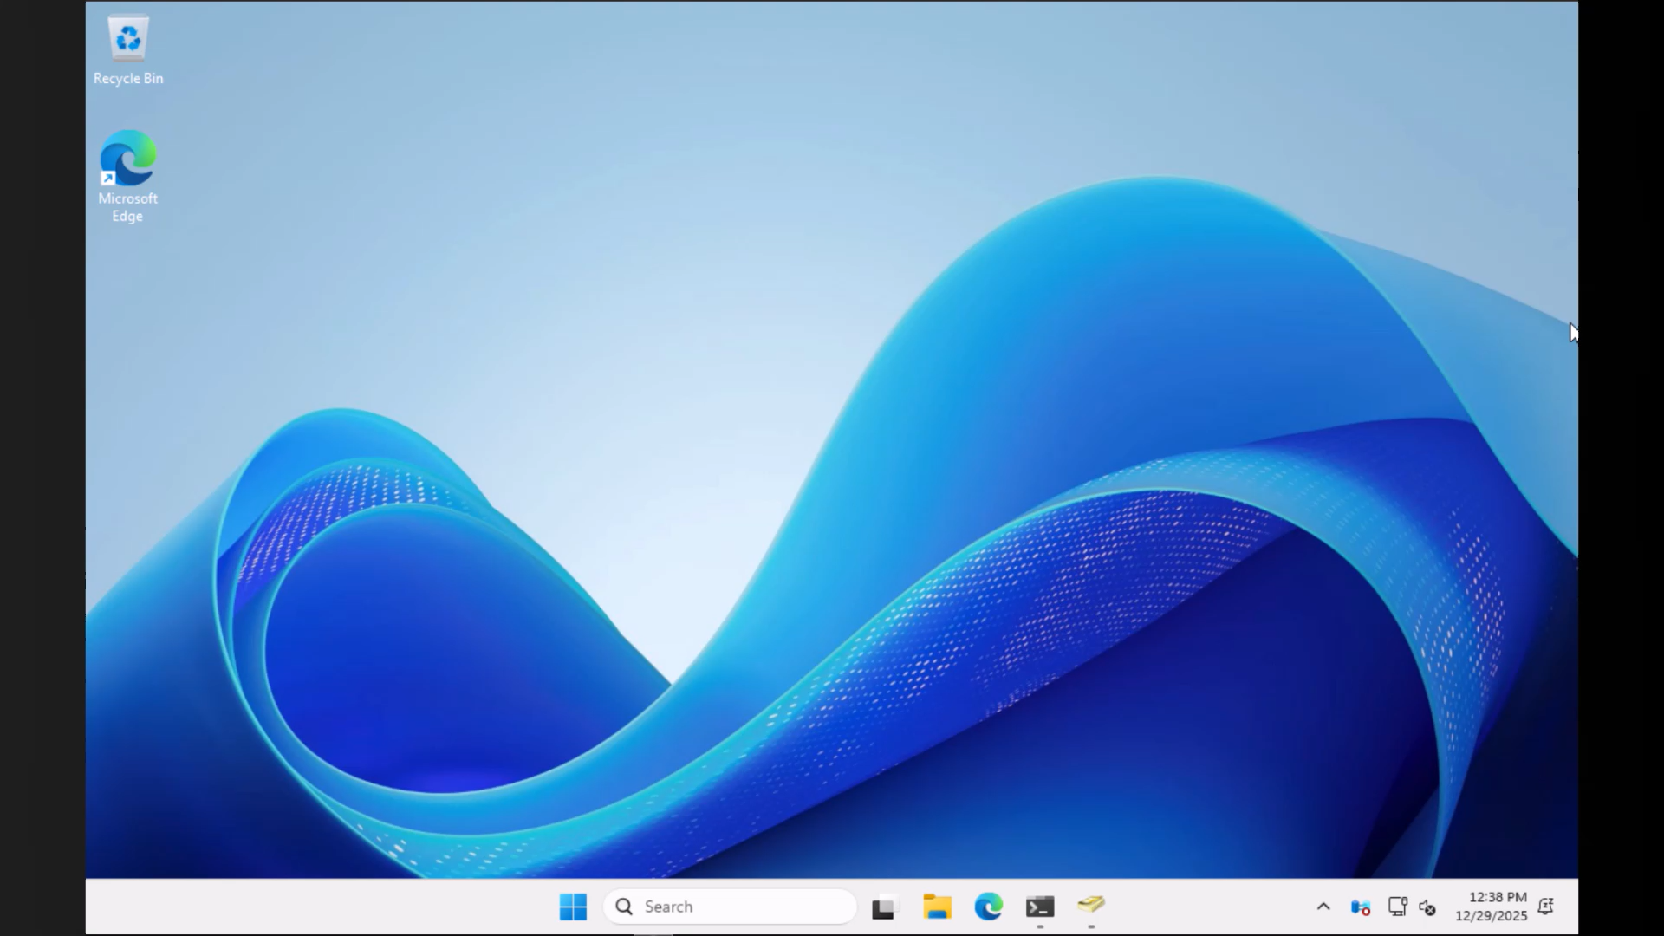
How to identify SQL Servers

Slide 15
How to identify SQL Servers
SQLCMD
SPN
Tools

Slide 16
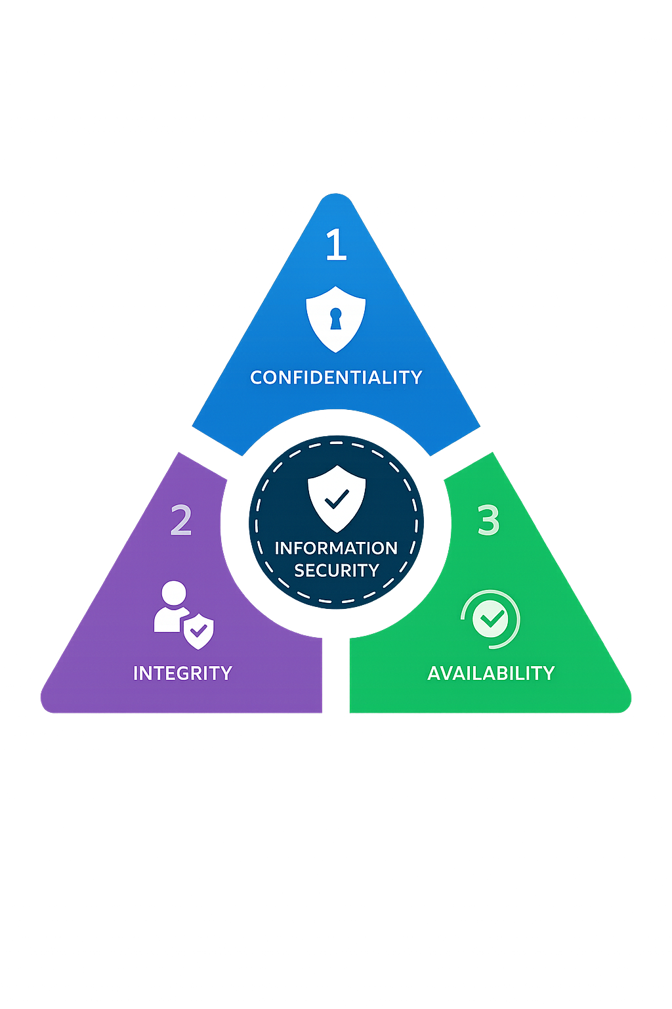
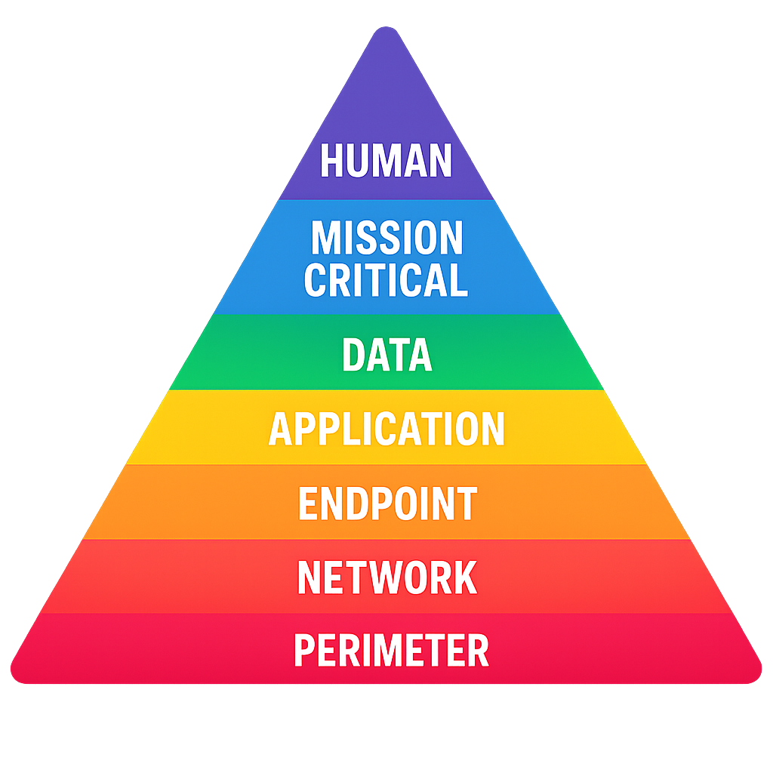
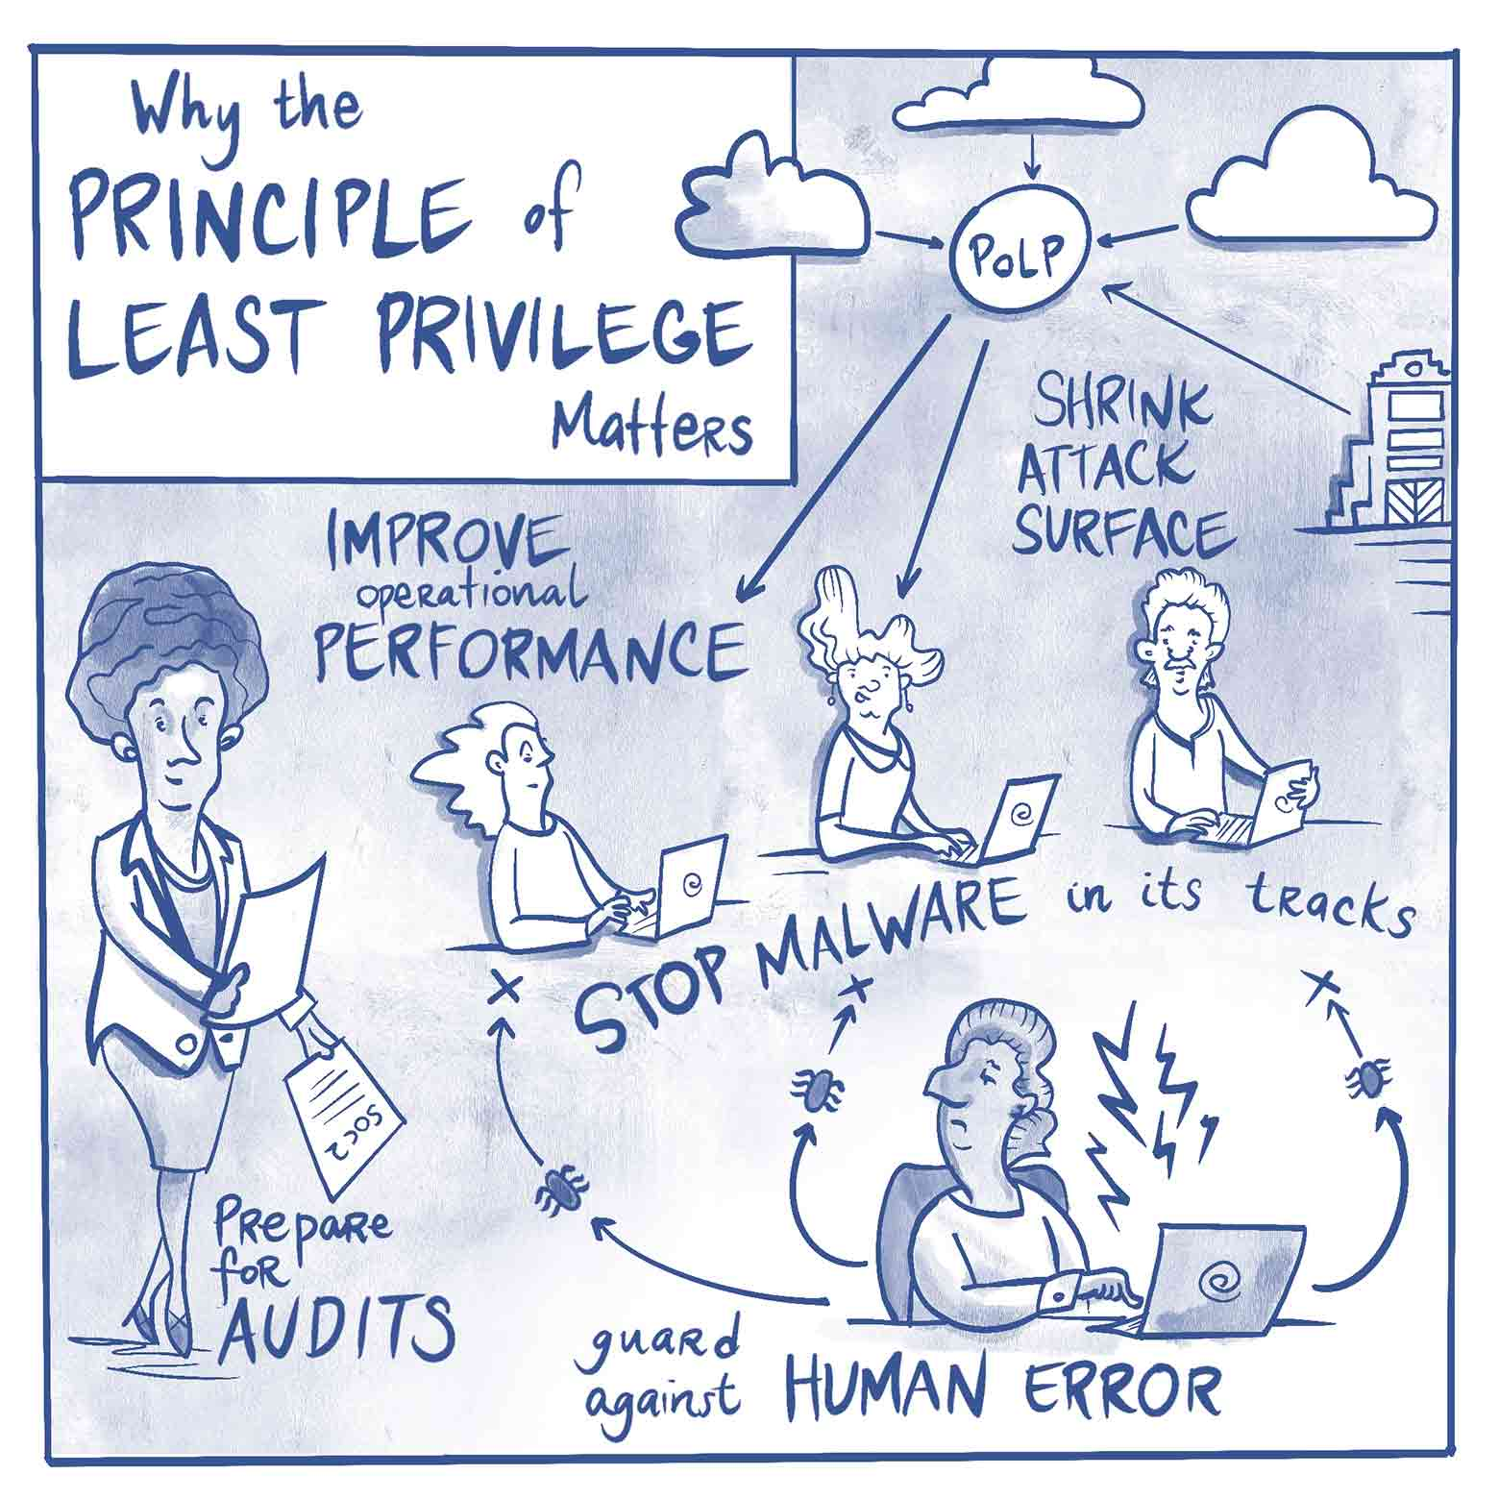

Core Security Principles
CIA Triad
Layered Security
Least privilege
Zero Trust
Attack surface in SQL Server

Slide 17
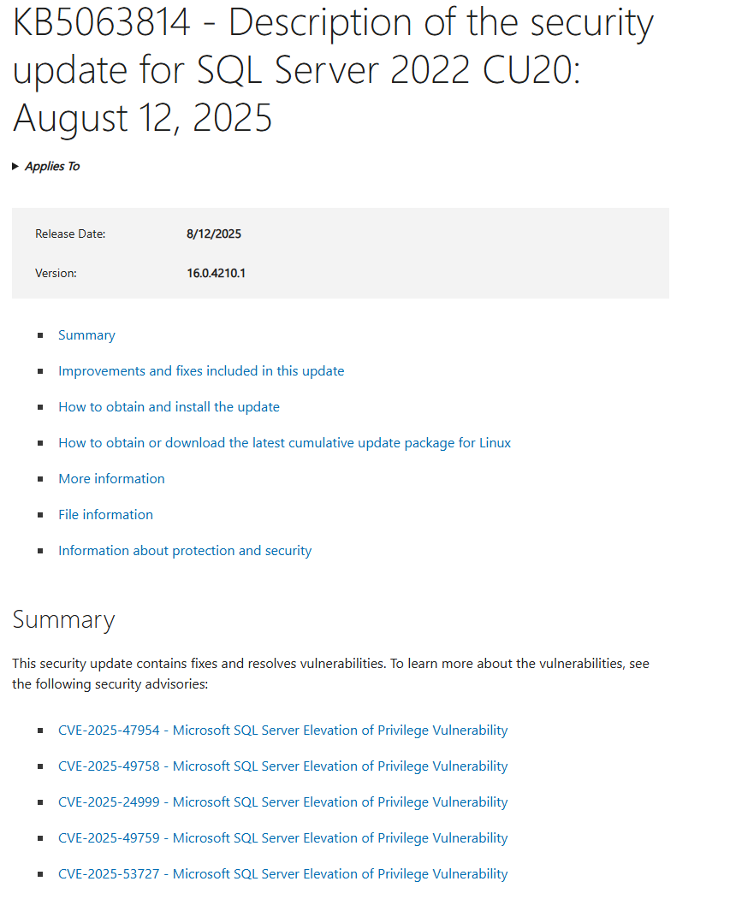
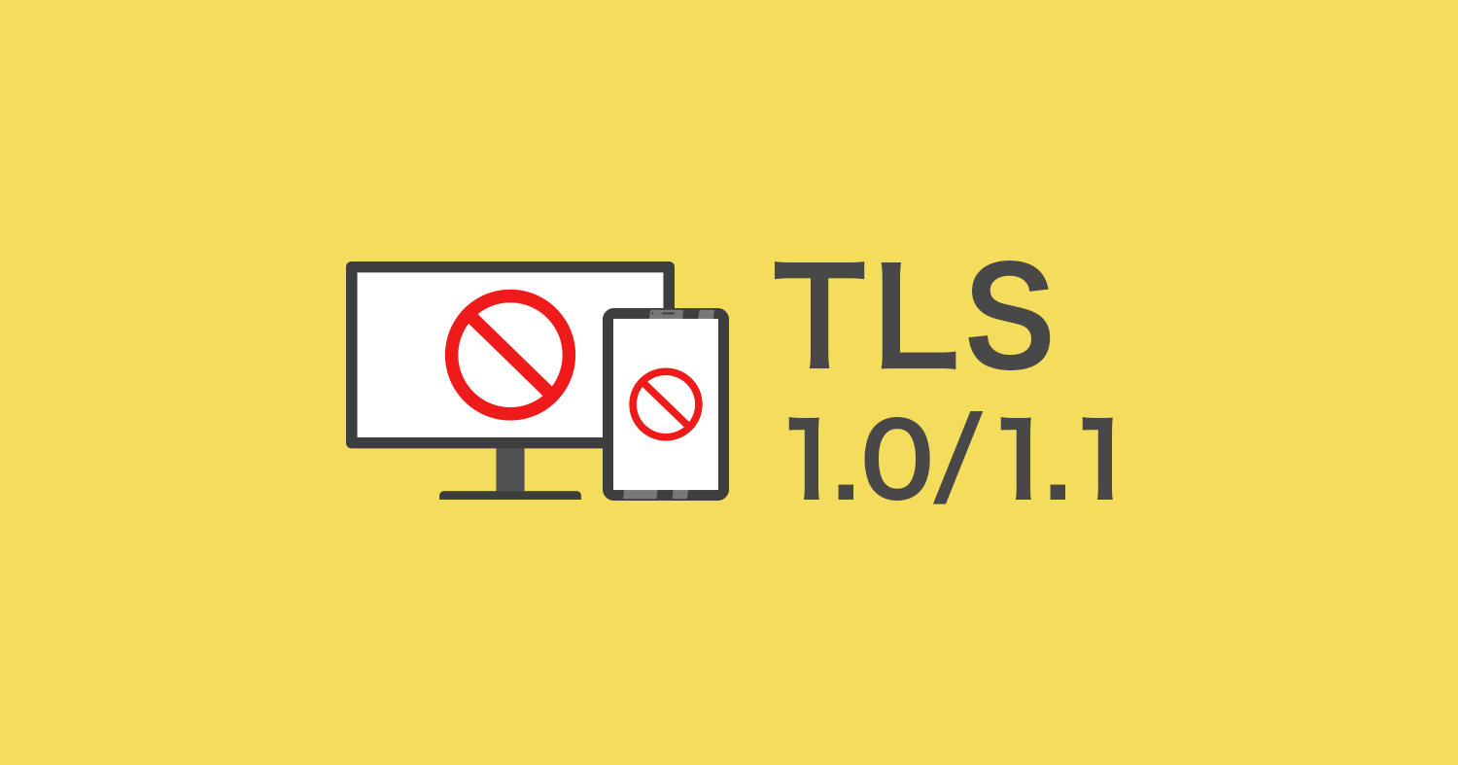
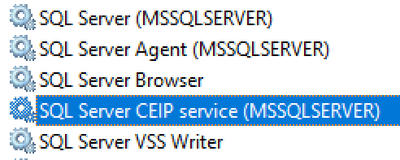
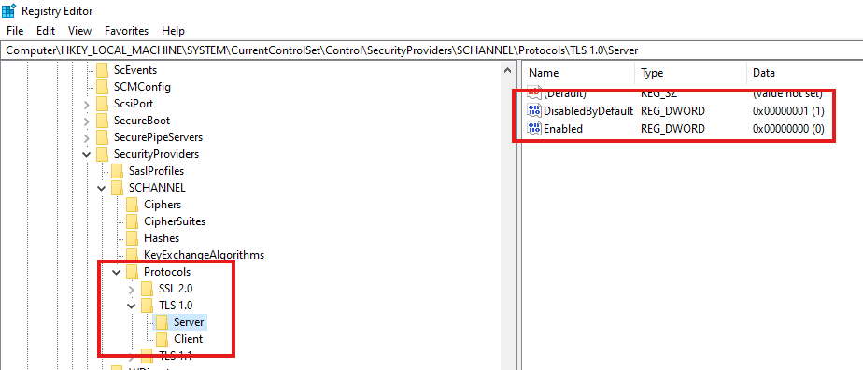
Reducing the Attack Surface
Unused features
Unnecessary Protocols
Patching
Firewall & Network Segmentation

Slide 18
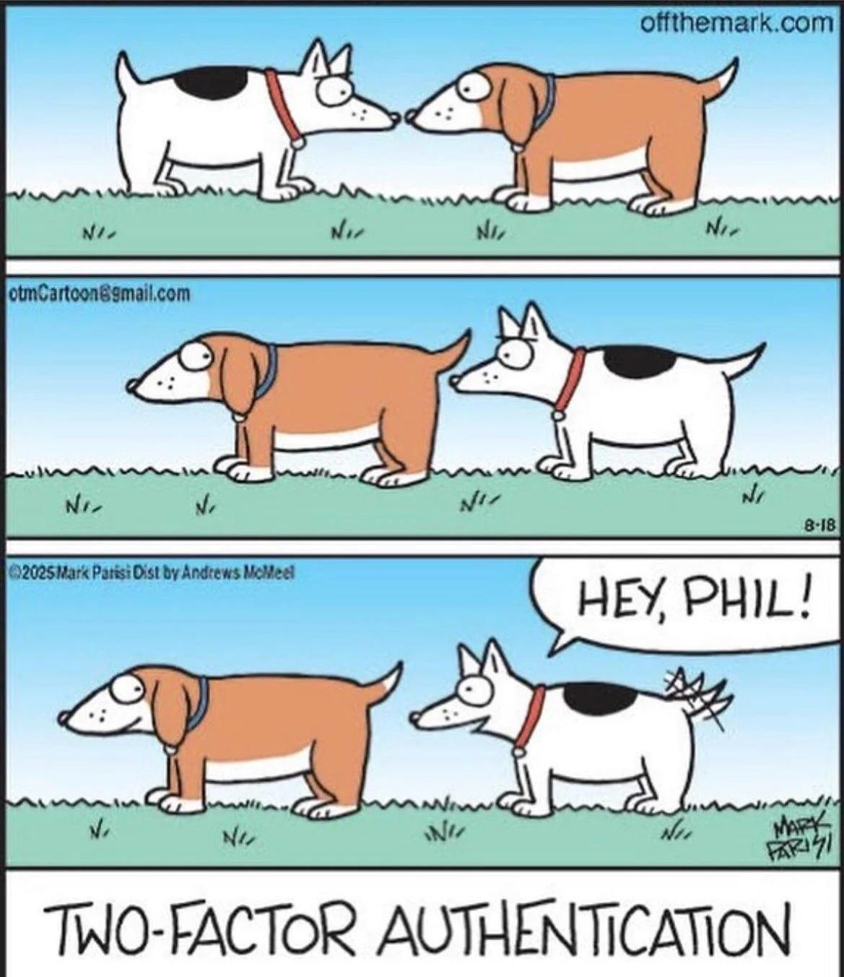
Authentication & Access Control
Windows vs SQL Authentication
Multi Factor Authentication
Role Based Access Control
Shared accounts
Access Review
SQL Server 2025 now uses PBKDF2 (RFC2898) for password hashing with 100,000 iterations, significantly slowing brute-force attacks

Slide 19
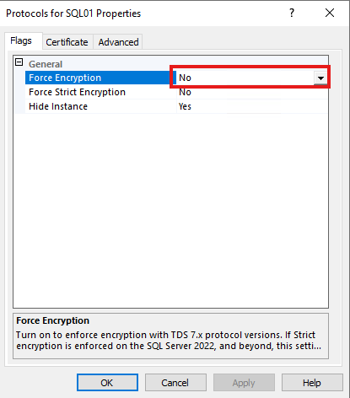
Encryption & Data Protection
In Transit: Transport Layer Security
At Rest: Transparent Data Encryption (TDE)

Slide 20
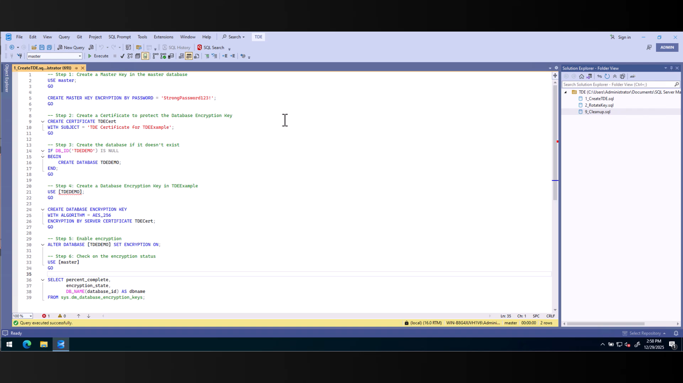
Encryption & Data Protection

Slide 21
Encryption & Data Protection
In Transit: Transport Layer Security
At Rest: Transparent Data Encryption (TDE)
In Memory: Always Encrypted

Slide 22
Back-up & Recovery Strategies
Last line of defense
Offsite/Immutable
RTO / RPO
Test Test Test!

Slide 23
Monitoring & Incident Response
SQL Server Auditing & Extended Events

Slide 24
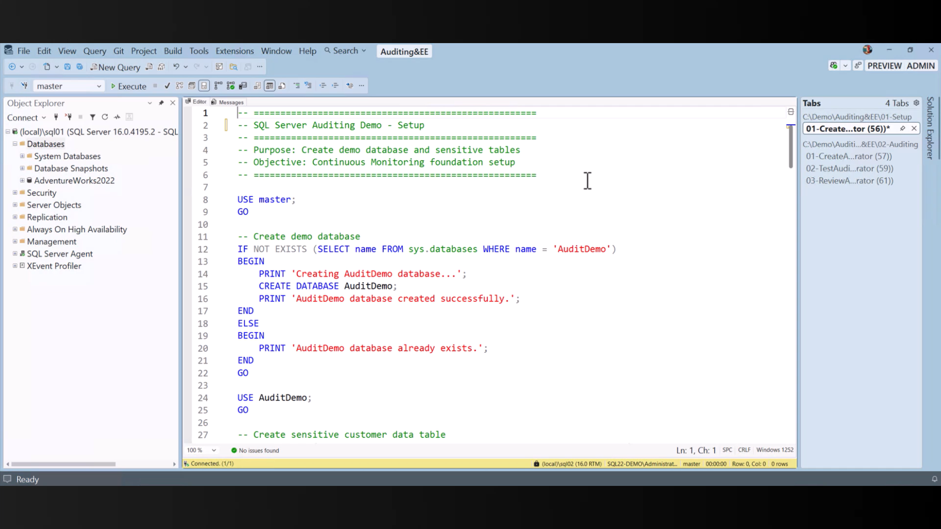
Monitoring & Incident Response

Slide 25
Monitoring & Incident Response
SQL Server Auditing & Extended Events
Alerting for suspicious behaviour
Incident Response Plan
Practice Practice Practise

Slide 26
Where to start?
Center for Internet Security (CIS)
Security Technical Implementation Guides (STIG)
SQL Server Assessment API
Talk to your security / architecture department

Slide 27
Key Takeaways
Security is proactive (even offline)
Layered defenses are essential (everywhere)
Encrypt sensitive data (even in memory)
Review, Test & Adapt

Slide 28
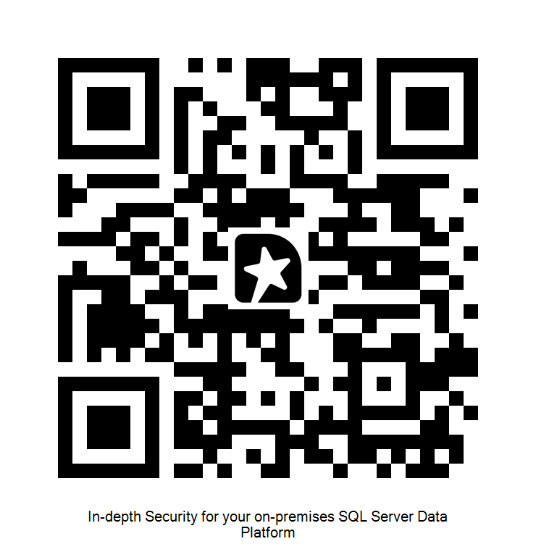
Feedback is appreciated!

Slide 29
Thank you for your time, patience and attention
Danny de Haan
/in/dannydh/
ThatInfraDba@pm.me
www.thatinfradba.com

